Slide 1
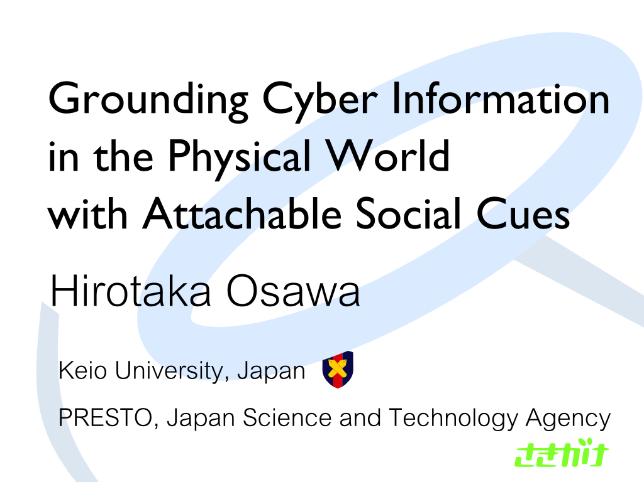

Slide 2
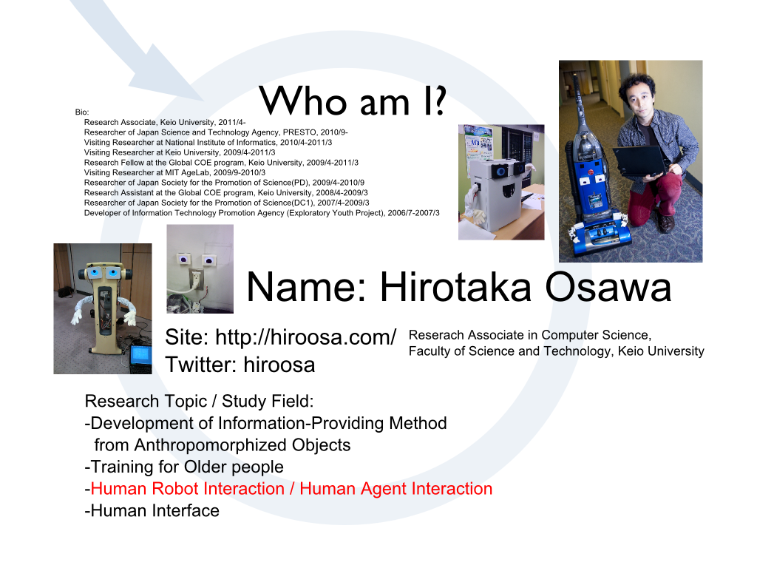

Slide 3
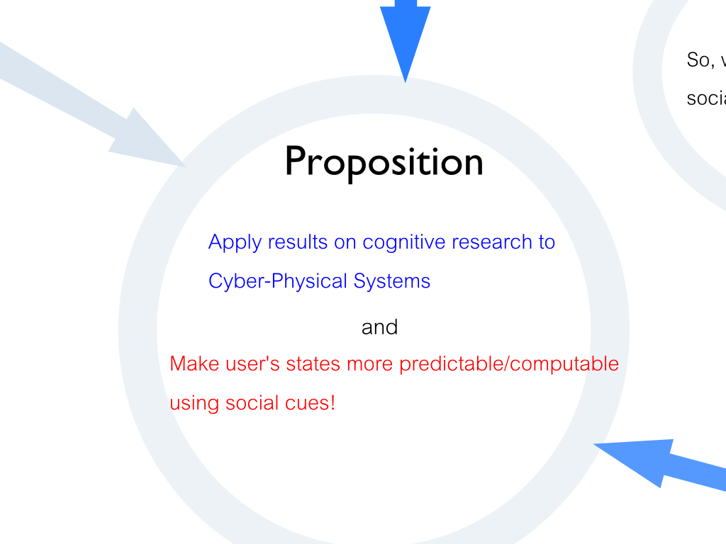

Slide 4
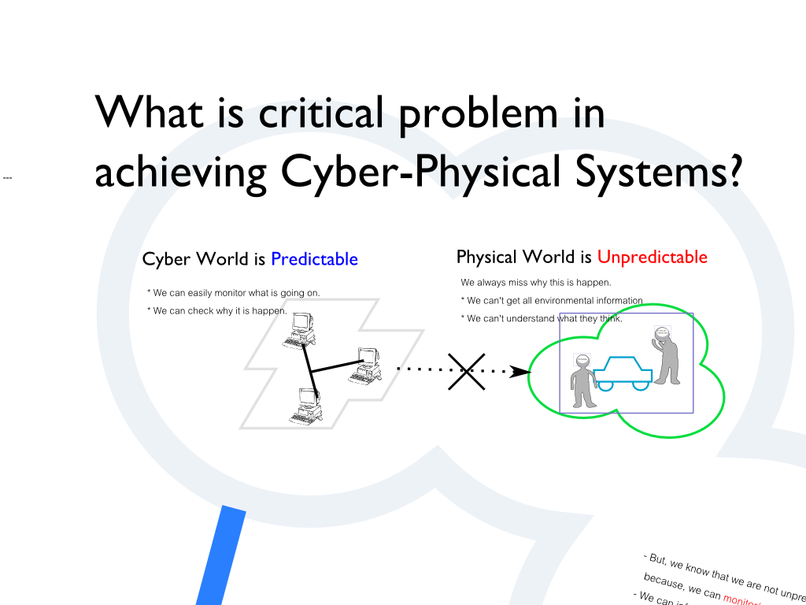

Slide 5
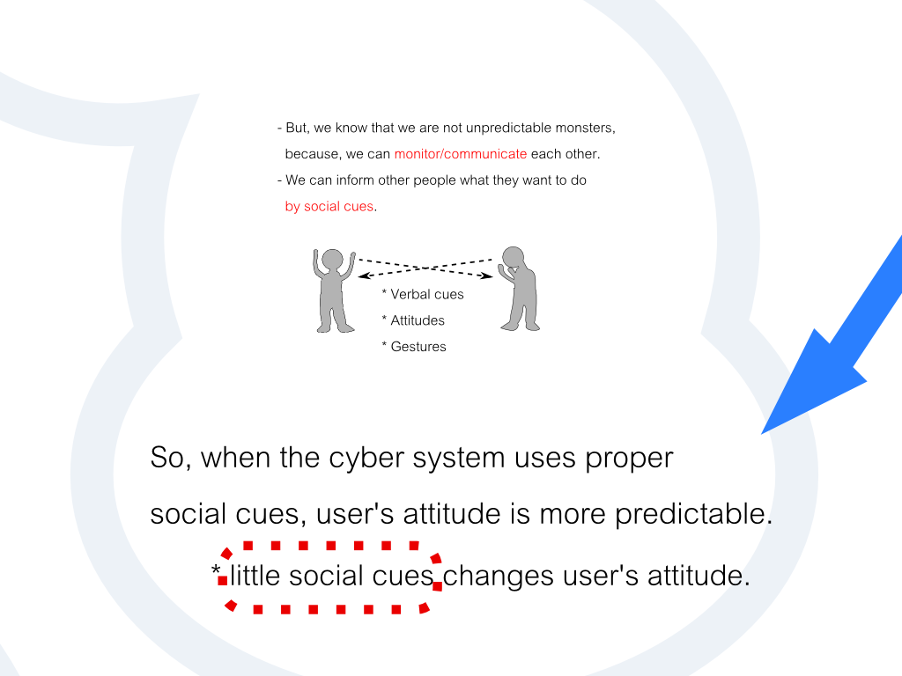

Slide 6
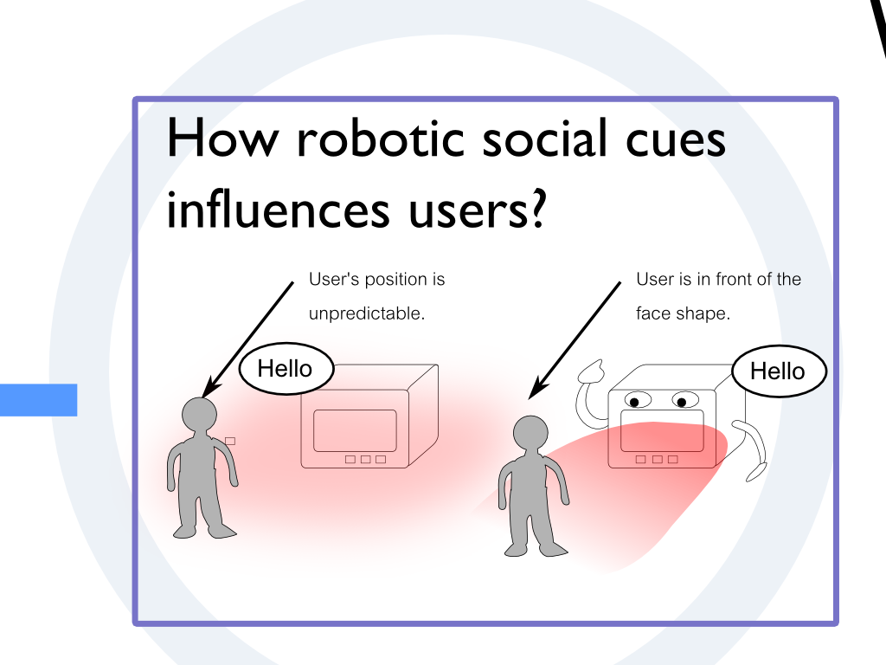

Slide 7
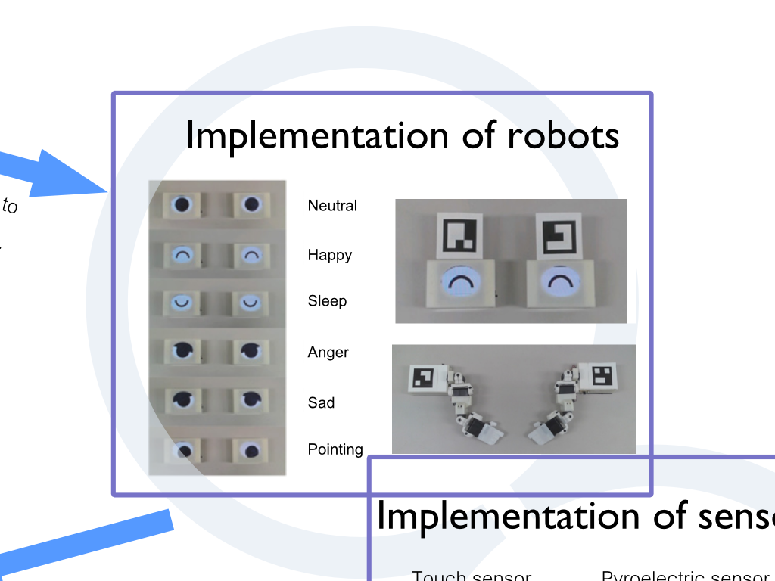

Slide 8
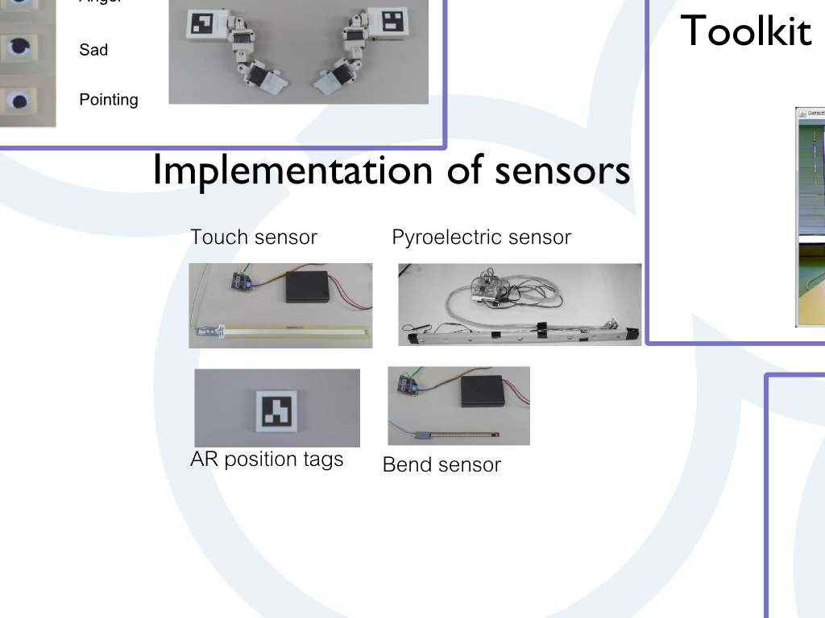

Slide 9
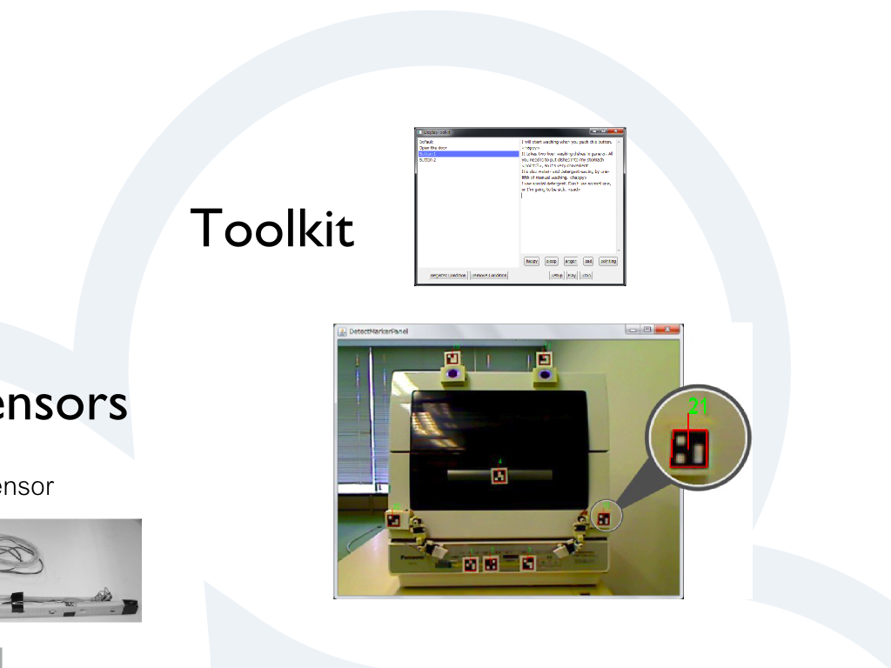

Slide 10
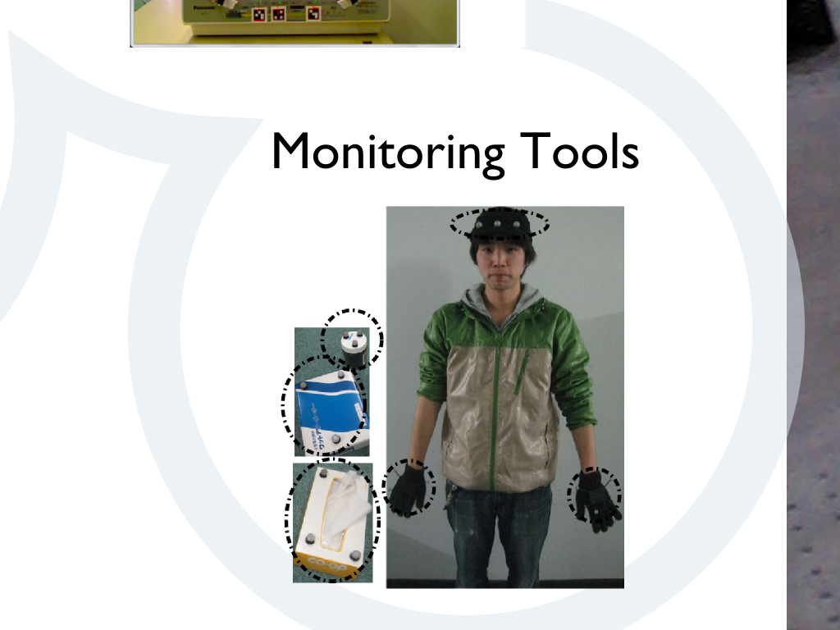

Slide 11
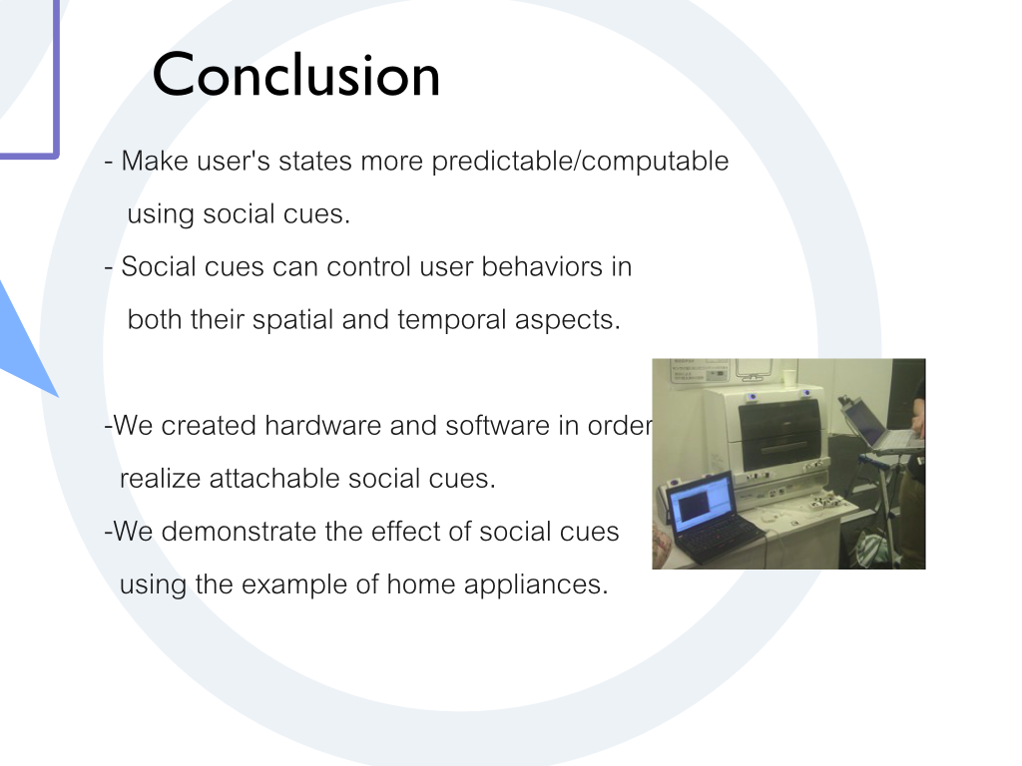

Slide 12
Development of Information-Providing Method from Anthropomorphized Objects
Hirotaka Osawa

Slide 13
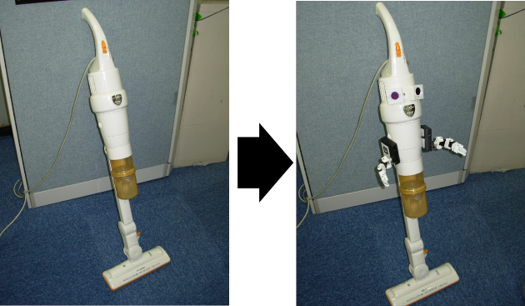
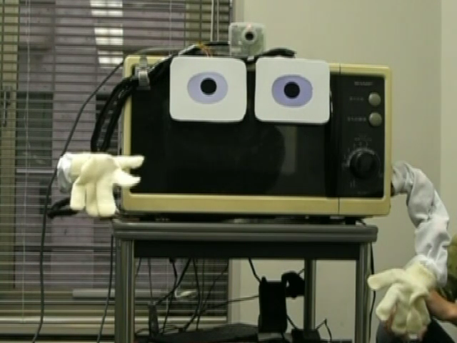
My study
Explanatory home-appliances in intelligent environment.
Attaching human-like appearance to home-appliances.
Making understandable interaction between a human and an object.
Anthropomorphized cleaner
Anthropomorphized electric oven

Slide 14
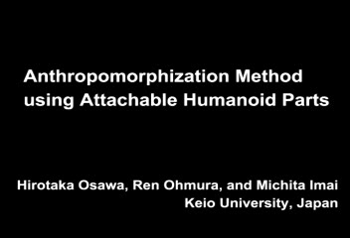

Slide 15
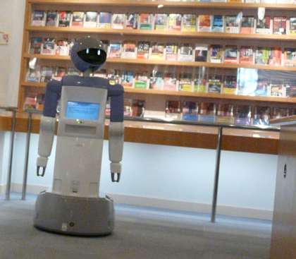
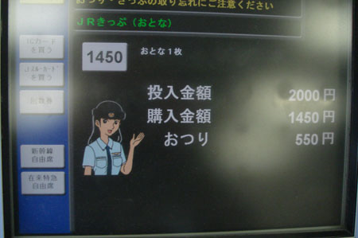
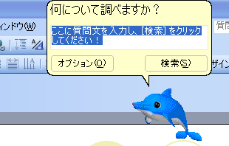
Background(1/2)
Many anthropomorphic agents are used for information service in society
CG agents, Robots …
CG Agent
Robot

Slide 16
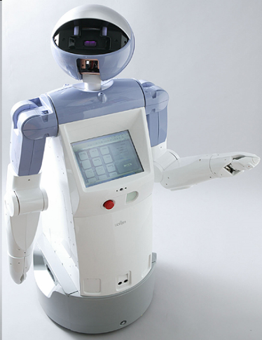
Background(2/2)
However, these agents often prevents information service because of its attractiveness.
?

Slide 17
Achievement
Change object as an agent directly
avoid additional agent in interaction
OK

Slide 18
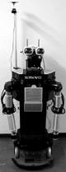
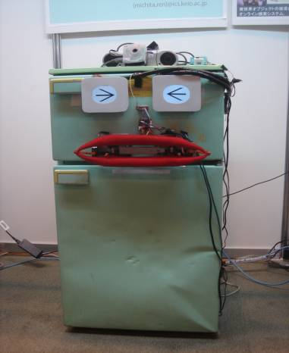
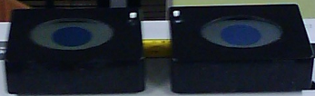
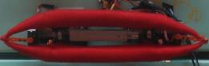
Design and Implementation (1/2)
Divide anthropomorphic aspect of an agent and attach it to an object directly
Agent
Functional
aspect
Object
Anthropomorphic
aspect
Anthropomorphic
aspect
Anthropomorphic
aspect

Slide 19
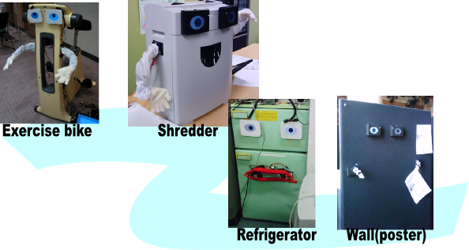
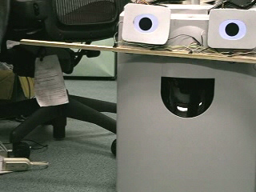
Design and Implementation (2/2)
I developed each output parts
Eye-like parts, arm-like parts, mouth-like parts, camera, voice recognition, skin sensor
wireless (by Bluetooth)
light and easy to attach everywhere (by Vercro tape)
Notes:
There is Display robot demonstration parts we made.
These parts are looks like agents parts but more light and easy to attach.
All parts has vercro tape in back.
And easy to attach anywhere.
An important point is that this device can use when users want to use anthropomoprhic agent.
Some parts has position sensor to detect its position. The display robot users its position to determine target object.

Slide 20
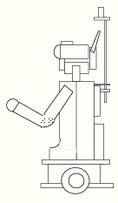
Validation method
Experiment: Compare numbers of remembered functions after information providing
by anthropomorphized object
by independent agent (humanoid robot Robovie)
Hypothesis: If target is anthropomorphized and no other provider is there, users can remember more functions.
My function is …
This printer has …

Slide 21
Results: remembered functions
More functions are remembered by our method
Explained functions
Our method
Robovie
6
5
4
the number of persons
3
2
1
0
0
1
2
3
4
Answered functions

Slide 22
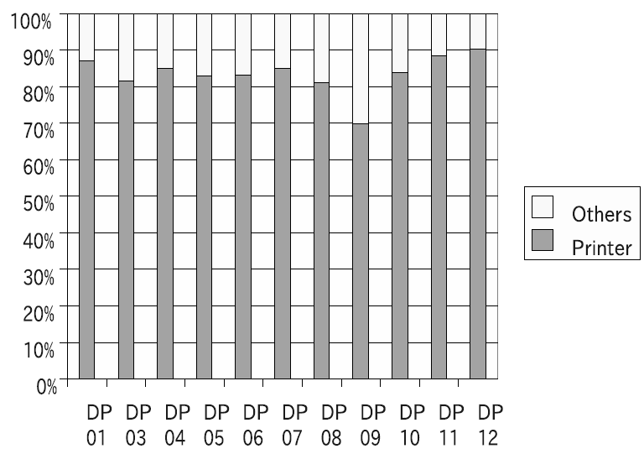
Results: gaze time
Our method： 0.851
Robovie: 0.419
Hindrance by robovie itself

Slide 23
Experiment: Imaginary Body Image
Notes:
省略？
擬人化によって得られる身体範囲はどこか？
「指示を行う元」をユーザがどう受け取るか？
たとえば「右」といった指示語が、「どこから」と受け取られるか測定すれば判断できるのでは？

Slide 24
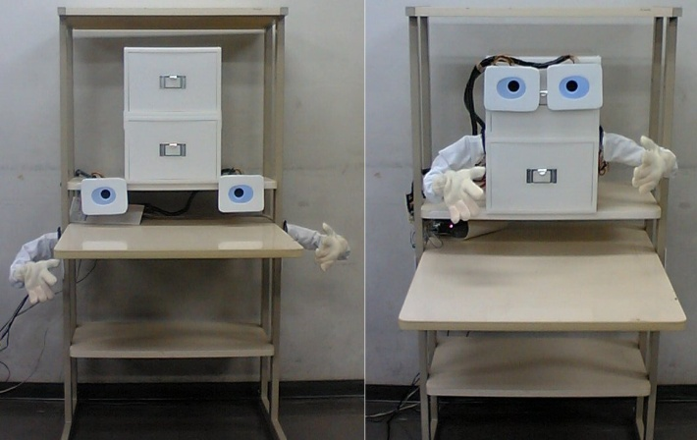
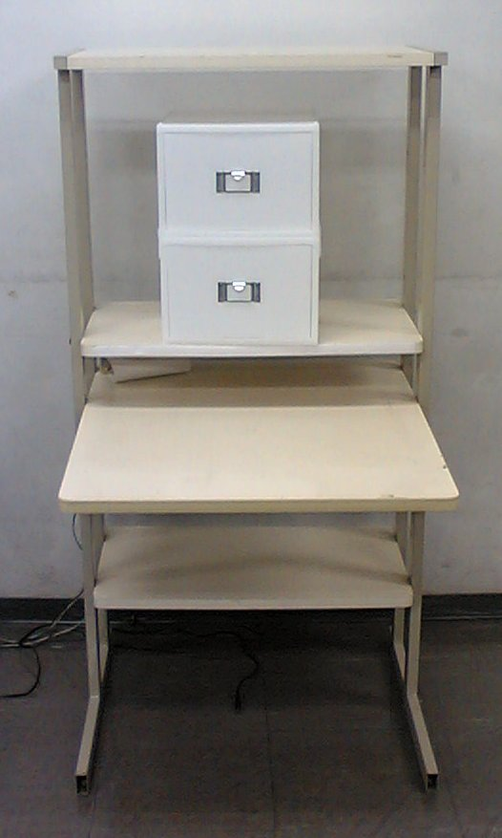
Result

Slide 25
Experiment: Attributes of users
Gender and age of users

Slide 26
Evaluation on gender factor

Slide 27
Evaluation on age factor

Slide 28
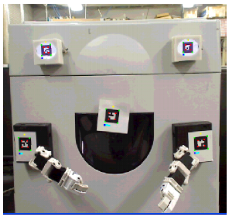
Application Kit
Development of anthropomorphization framework
Store staffs in an electric shop, users in home, etc.

Slide 29
Demonstration

